Slide 1



Using a* to solve a rubik’s cube

Slide 2
Introduction to the Rubik's Cube Structure

Slide 3
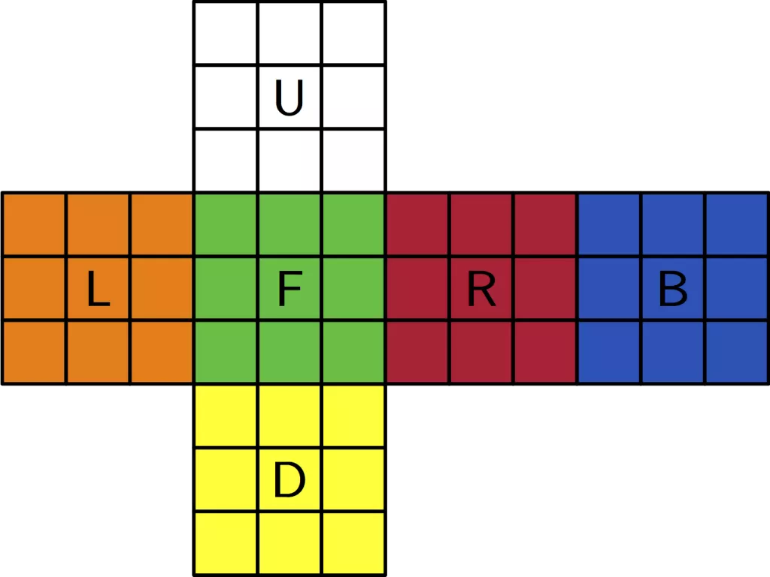

Slide 4
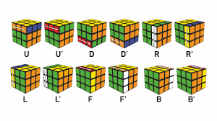

Slide 5
string solvedConfig = "WWWWWWWWWYYYYYYYYYBBBBBBBBBGGGGGGGGGRRRRRRRRROOOOOOOOO";

Slide 6
a* algorithm

Slide 7
A* Algorithm
A* (A-star) is a search algorithm that finds the shortest path to solve a problem by combining two factors:
g(n): The actual cost from the start to the current state.
h(n): A heuristic estimate of the cost from the current state to the goal.
f(n) = g(n) + h(n): The total estimated cost from the start to the goal.

Slide 8
Why Use A for Rubik’s Cube?
A* is effective because it uses both the known and estimated moves to guide the search, narrowing down paths that are likely to lead to the solution more quickly than random or brute-force methods.

Slide 9
understanding the heuristics

Slide 10

Heuristic in Rubik’s Cube: We need an estimate for how "far" a scrambled cube is from being solved.

Slide 11
Examples of Rubik's Cube heuristics
Manhattan Distance: Measures how many face moves are needed to bring each piece to its goal position.
Pattern Database: Precomputes and stores solutions for specific parts of the cube, allowing us to quickly check how many moves are needed for these subsets.

Slide 12
Solving the Rubik's Cube Using A*

Slide 13
Initial Setup: Start with a scrambled cube configuration, represented as a string.
Goal: Transform this scrambled configuration into the solved configuration (e.g., "WWWWWWWWWYYYYYYYYYBBBBBBBBBGGGGGGGGGRRRRRRRRROOOOOOOOO").

Slide 14
Define the Initial State:
Start with the scrambled cube configuration, which we’ll call initialConfig.
Set the Goal State:
Define the solved cube configuration, solvedConfig.
Initialize Priority Queue:
Insert initialConfig into a priority queue with g=0 (starting moves) and h= calculated by our heuristic.

Slide 15
Main A Loop*
Pop State from Queue: Take the state with the lowest f(n)f(n)f(n) value.
Goal Test: Check if this state matches solvedConfig. If yes, backtrack to reconstruct the sequence of moves.
Generate Successors: For the current configuration:
Apply each of the 12 possible moves (e.g., U, U', R, R', etc.) to create new configurations or "successors."

Slide 16
Main A Loop*
For each successor:
Calculate g(successor)=g(current)+1
Compute h(successor)
Set f(successor)=g(successor)+h(successor)
Add Successors to Queue:
Only add successors that improve the path or haven’t been visited yet.
Keep track of each state’s g(n)g(n)g(n) value to ensure minimum path cost.

Slide 17
Main A Loop*
End Condition:
The algorithm ends when we find a path to the solved state, displaying the move sequence required to solve the cube.

Slide 18
c++ topics which we haven’t covered yet

Slide 19
Structures (struct): Used to define the CubeState structure, which holds each cube configuration, the cost so far, heuristic, and total cost for A*.
Priority Queue (priority_queue): Manages the open set, storing cube states sorted by their f values (for selecting the most promising state).
Unordered Map (unordered_map): Used to store the minimum g scores and paths for each configuration, supporting fast lookups.
Standard Template Library (STL): Using containers like priority_queue, unordered_map, and vector, and algorithms such as std::reverse.
OOP
Dynamic Memory Allocation (Implicit): The STL containers manage memory allocation and deallocation dynamically as they grow.

Slide 20




let’s solve a
rubik’s cube ;)

Slide 21
Thank
You

